Slide 1
Challenger Rep Module
Shifting Trelegy Reps towards becoming Challenger Reps using CES data
Notes:
Target HCPs: Fence sitters, who thinks all SITTs are the same

Slide 2


How Challengers Win
Voice of the Customer*
I value sales professionals who…
Offer me unique, valuable perspectives on my market
Help me navigate alternatives
Help me avoid potential risks
Educate me on new issues and outcomes
Teach
Take Control
Constructive
Tension
Tailor
Shift behavior to compel the customer to take action
*Challenger Performance Optimization Inc. Research
Build
Constructive Tension
Notes:
According to Challenger Performance Optimization Inc. Research, customers value sales professionals who:
Offer me unique, valuable perspectives on my market
Help me navigate alternatives
Help me avoid potential risks
Educate me on new issues and outcomes
In their research, they also found that most effective Sales Reps Teaches, Tailors and Takes Control of the buying process – the Prescription process.
They call these sales professionals ‘CHALLENGERS’.
One of the key differentiators of these Challengers is that they BUILD CONSTRUCTIVE TENSION in order to Shift behavior to compel the customer to take action

Slide 3
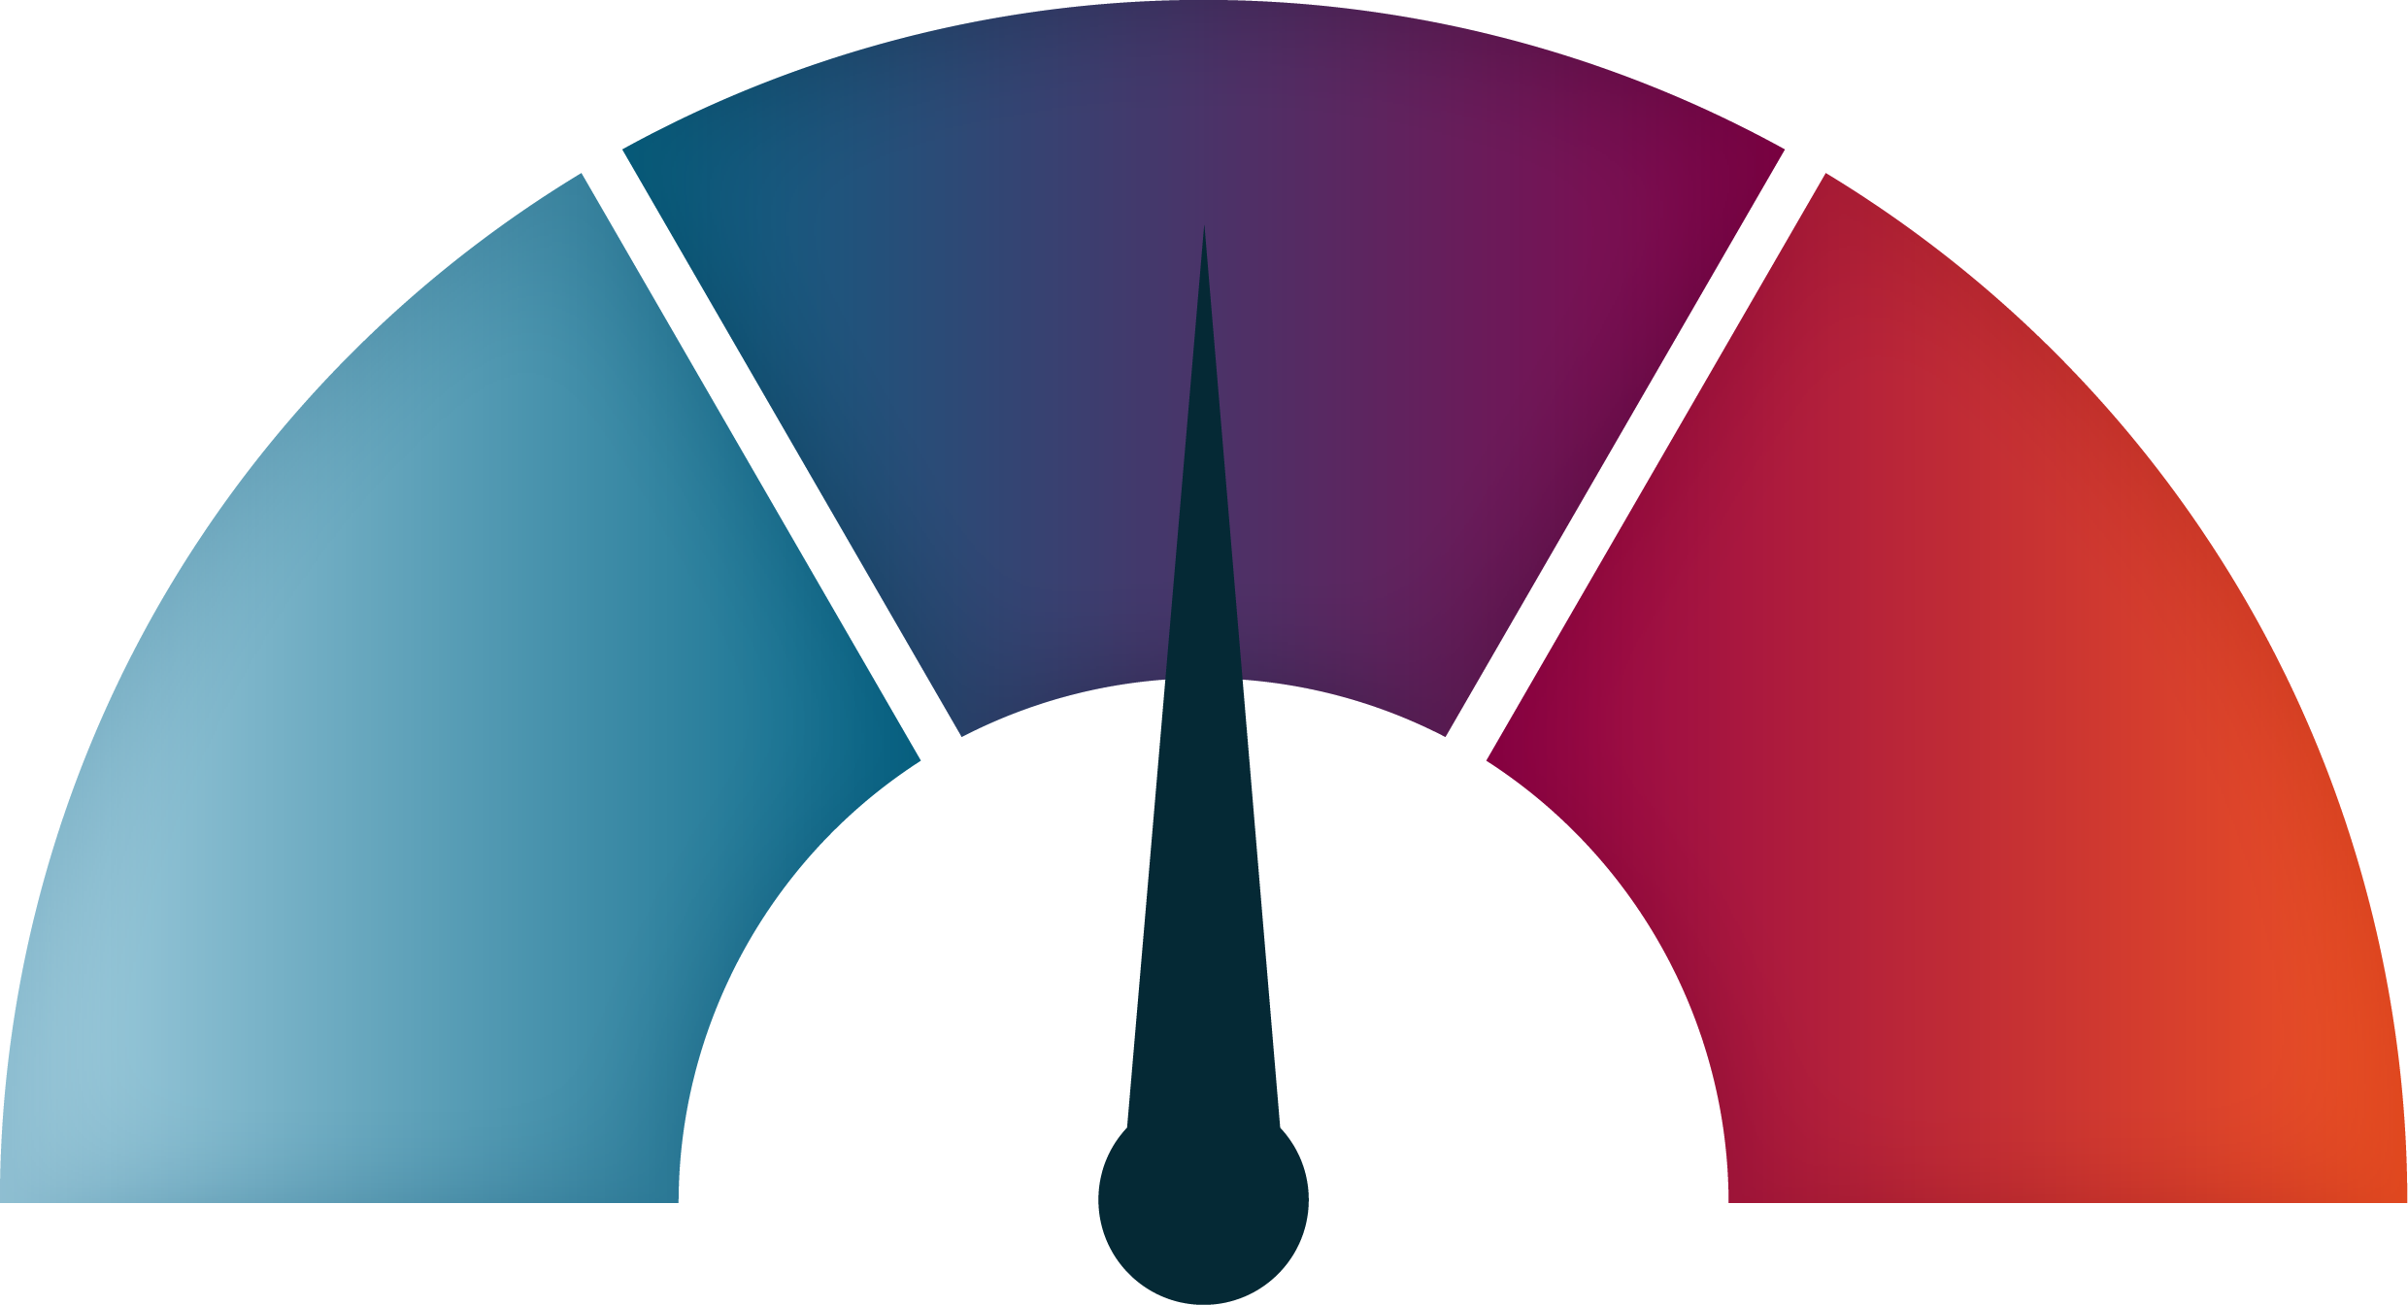


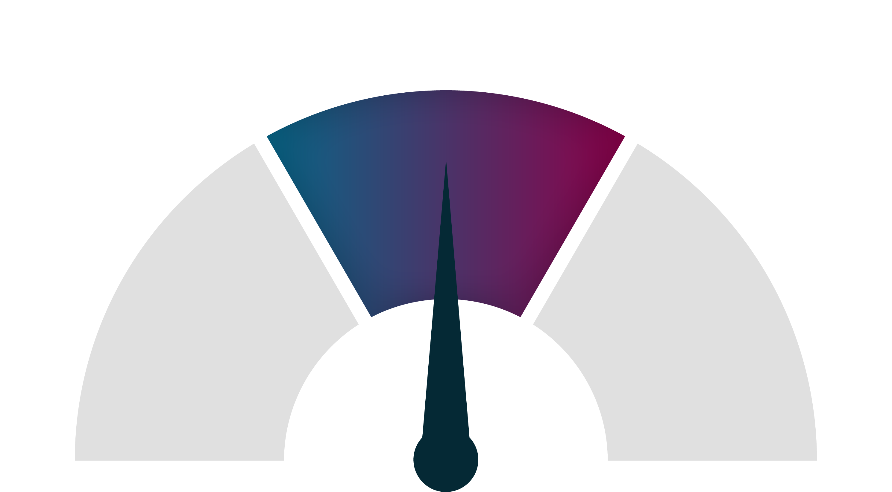
Challenge The Status Quo
Constructive Tension
A productive force that moves the interaction into unfamiliar and/or uncomfortable territory where the HCP feels compelled to take clinically appropriate action
Creating Constructive Tension
Constructive Tension
(Assertive)
No Tension
(Passive)
Too Much Tension
(Aggressive)
Relaxed
Leaning back in chair, at ease
Nonchalance (like information is old news or the customer doesn’t feel like they have a problem)
No need for action
Dial of Tension
Stressed
Arms crossed, shut down
Sounding defensive, heightened tone of voice
Refuses action, questions seller’s intentions
No tension
Relaxed
No need for action
Tension
Stressed
Shut down
Refuse action
Intrigued
Leaning forward in chair, appears engaged
Asking lots of questions, may even seem skeptical (because gears are turning)
Need for action
Notes:
Construction tension is defined as a productive force that moves the interaction into unfamiliar and/or uncomfortable territory where the HCP feels compelled to take clinically appropriate action.
As sales professionals, most default is to avoid creating tension with a customer because you think that it is detrimental to your relationship…
…However if there is not enough tension in the call, the HCP will not be compelled to take any action
…Although in case of too much tension, they may feel personal affront and shut down on you
Therefore, you need to be skilled here to create the right amount of tension, to challenge the HCP’s thinking but not to challenge them personally. Ultimately, driving them to take a clinically appropriate action

Slide 4
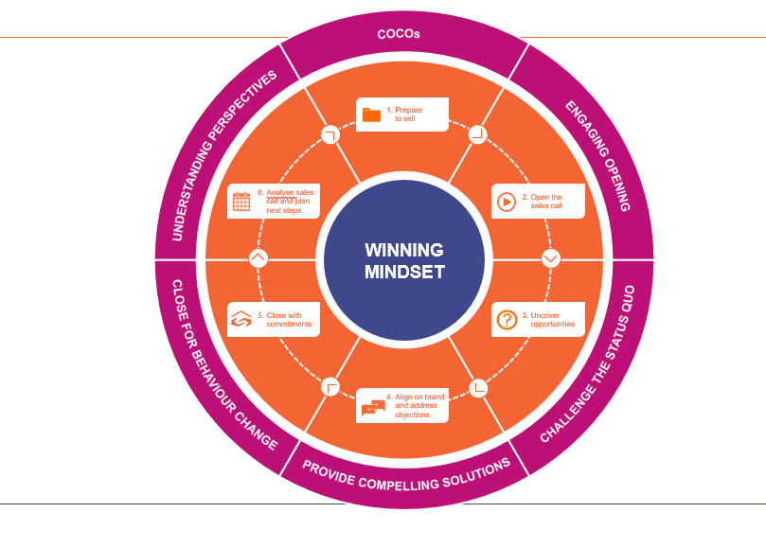
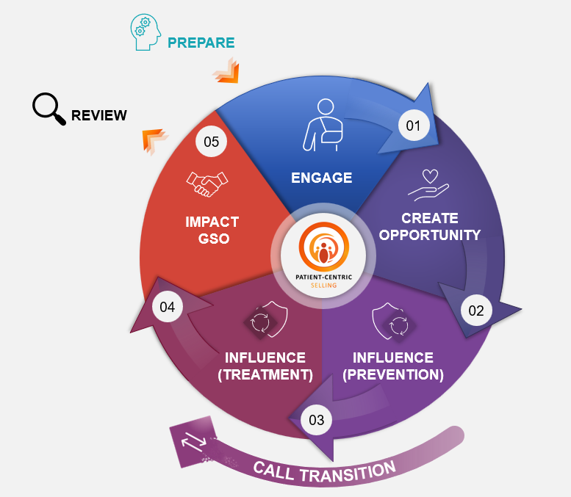

4
PFSS/GSO Model
PCS Model
Constructive tension
Constructive tension
PFSS/GSO : Patient Focused Scientific Selling / Good Selling Outcomes
PCS : Patient Centric Selling Model
Notes:
Whichever Selling model you are using, creating constructive tension can be demonstrated in these steps.

Slide 5

Disrupting the Status Quo by addressing customer problem in a right way
Present an idea that changes how your customer views their situation or problem
A
B
GAP
Current State
New Approach
Captures the customer’s current thinking
What the customer is missing
Offers a new way to address the problem (leading to your solution)
A 3-Phase Message
(1) Share a reframe
(2) Introduce Impact
(3) Reveal Value
Notes:
According to Challenger, when we create Constructive tension, we disrupt the status quo. We do this by addressing the customet problem in a right way. What you are seeing is an abridged framework fo delivering a 3-phase message
Let us zoom in on how we deliver the REFRAME or current state to GAP

Slide 6
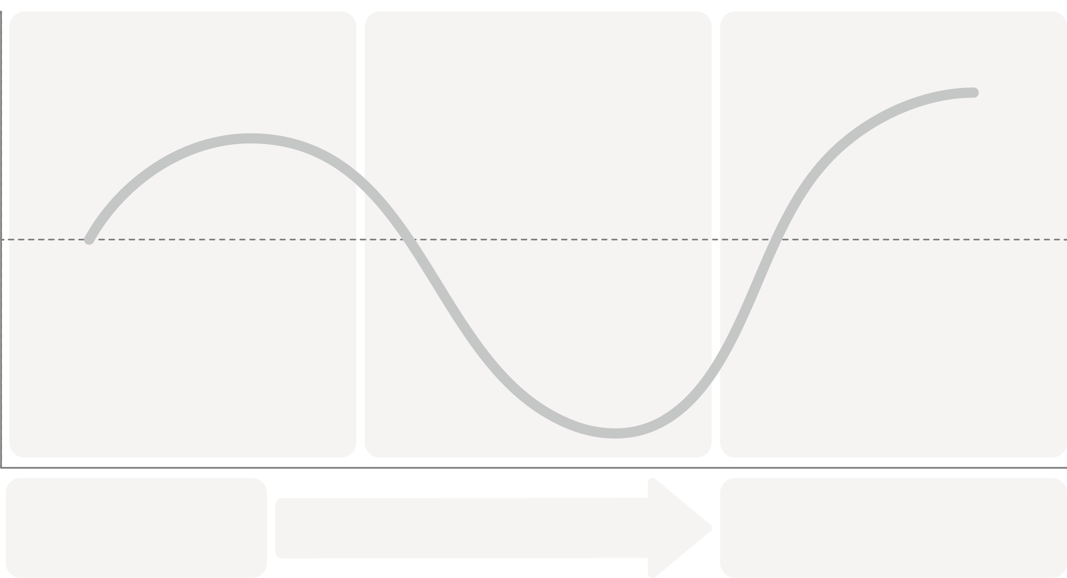
A 3-Phase Message
In summary
Positive
Share Reframe
Introduce Impact
Reveal Value
Customer Emotional State
Neutral
Negative
A
B
GAP
Current State
New Approach
Notes:
Let us zoom in on how we deliver the REFRAME or current state to GAP – this is the first bucket that you are seeing on the screen

Slide 7



Characteristics of a Reframe
An Effective Reframe is…
Surprising
Sizable
Solvable
Must be unexpected
Must be worth solving
Must eventually lead back to you
Notes:
Insert – Surprising – DID YOU KNOW THAT EXACERBATIONS INCREASE….

Slide 8

Scripting Your Reframe
A
“HOWEVER”
Gap
Current State
Captures the customer’s current thinking
What the customer is missing
In your words, empathetically describe the status quo
Signal a pivot with a strong transition word or phrase
Reveal the flaw in that way of thinking about the issue
Sample Phrasing:
Last time we met, you explained…
Most pulmonologists like you tell us they spend a lot of time thinking about…
Many of your colleagues have expressed that…
From our conversations with KOLs, they have shared that…
When it comes to COPD treatment, we hear that most HCPs are challenged with…
Many doctors emphasize the importance of…
Sample Phrasing:
…nevertheless…
…surprisingly…
…but in fact…
…unfortunately…
…the reality is…
…that being said…
…in contrast…
Sample Phrasing:
…what you are not considering is…
…similar companies continue to overlook…
…the gap is bigger than you think…
…your customers see this differently…
…the downstream issues are costly…
…this is actually slowing you down…
…this only works X% of the time…

Slide 9
Let’s apply!
Doctor, based on our previous conversations, you've emphasized your goal of helping patients reduce symptoms quickly while minimizing their risk of exacerbations and you have seen how Triple Therapies can address this
Many pulmonologists use triple therapies interchangeably, assuming they deliver similar outcomes. This means that patients are not getting the most of the treatment, possibly, leading to higher risk of exacerbation
The sample dialogue provided in this presentation are for illustrative purposes only.
These materials must be reviewed and locally approved by the Medical Affairs team prior to use in any healthcare professional (HCP) interactions.
Notes:
Rep: Doctor, based on our previous engagements, you have made it clear that your goal is to ensure patients are seeing less symptoms and improving quickly, along with reduced risk of exacerbations.
Most Pulmonologists are using Triple Therapies interchangeably and believe that they are all the same.
What they failed to realize is that not all are the same in reducing moderate to severe exacerbations among COPD patients

Slide 10

Gathering your Inputs: Seek First to Understand
Suggested
Activity
Individual Activity
What is the general treatment goal of the HCP in treating COPD/Asthma?
How are they trying to accomplish #1 now?
(What are the positive things they are doing now, that they believe are actually doing something; these are things that DO NOT include the GSK Solution)
What makes sense (to them) about doing it this way?
(What logic/reasoning would they agree with? Be empathetic here; we don’t want to make them feel that their approach is a “bad” thing at this point.)
What’s at stake/at risk if they continue to do it this way?
(What don’t they see or fully appreciate?)
Notes:
UNDERSTAND PROBLEM FIRST BEFORE SOLUTION
Discipline not to mention brand

Slide 11
Suggested Activity
Suggested
Activity
Fill in the blank reframe
Fill in the Blank Reframe
A
We understand that your goal is to ___________ In our previous call, you shared that you manage COPD by prescribing ________and __________, because ___________ .
(#1)
When done right:
Opens conversation, builds credibility
When done right:
Gets verbal agreement, “head nod”
Current State
(#2)
(#2)
Captures the customer’s current thinking
(#3)
In your words, empathetically describe the status quo
However,
…What is happening is that___________.
When done right:
Elicits reaction - “I never thought about it that way before…” or “wait a minute…what are you talking about?”
Gap
(#4)
What the customer is missing
Reveal the flaw in that way of thinking about the issue

Slide 12
Developing a Reframe
Suggested
Activity
Develop a reframe anchored on your answers to the 4 questions
A
Current State
Captures the customer’s current thinking
However,
Gap
What the customer is missing
Notes:
Develop a reframe anchored on your answers to the 4 questions

Slide 13
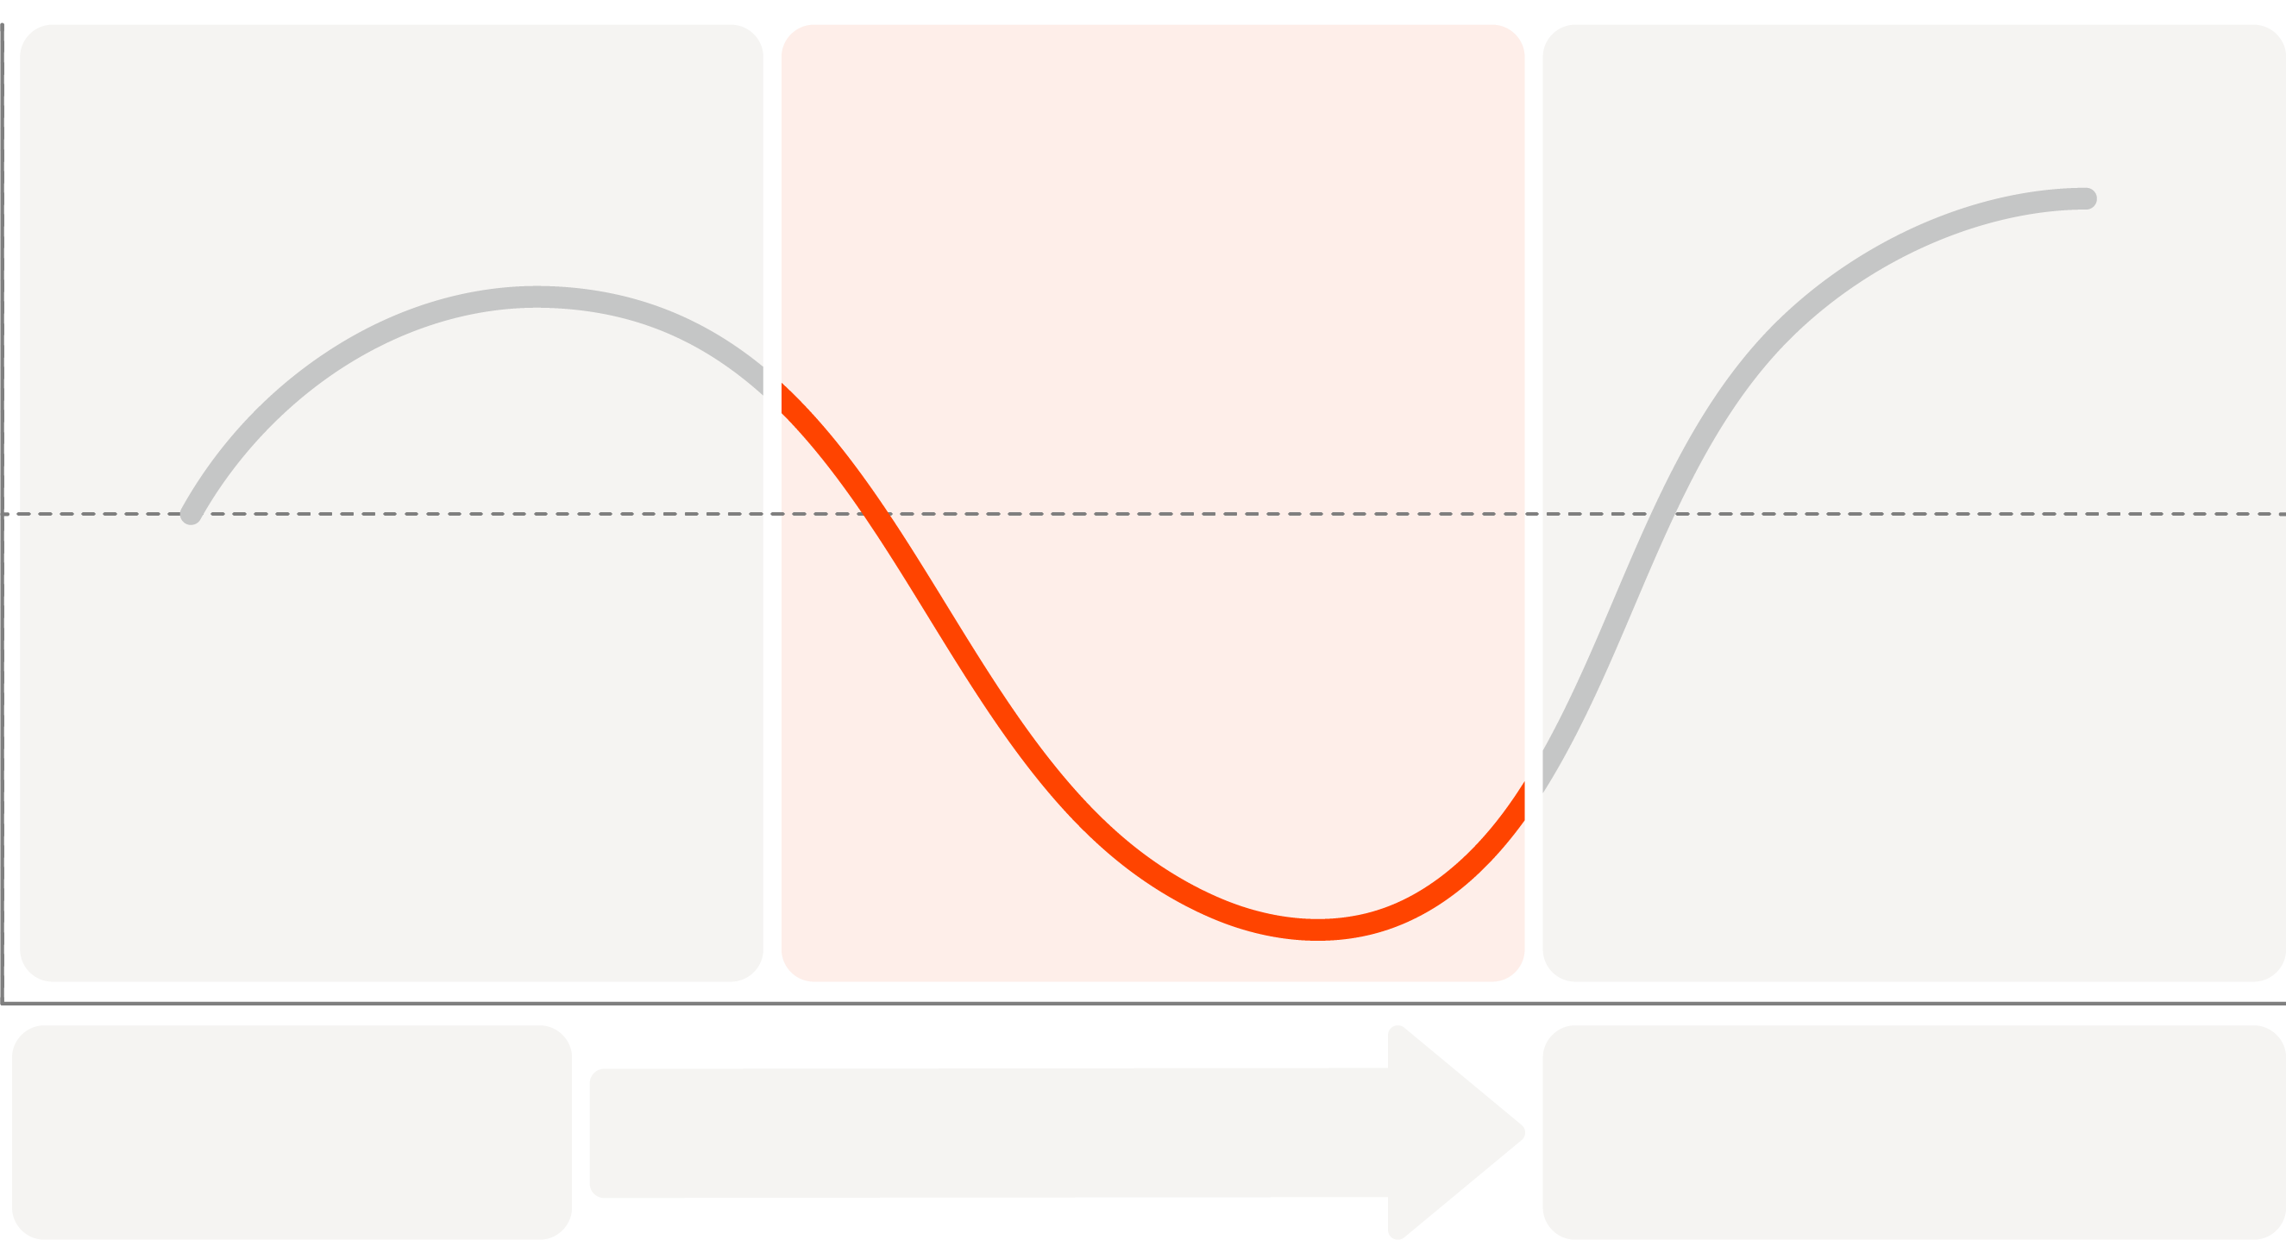
Focusing On: Introduce Impact
Introduce Impact:
Positive
Share Reframe
Introduce Impact
Reveal Value
Intensify the business consequences and humanize the problem by articulating the cost of staying the same.
Customer Emotional State
Neutral
Negative
A
B
GAP
Current State
New Approach
Notes:
Intensify the business consequences and humanize the problem by articulating the cost of staying the same.

Slide 14
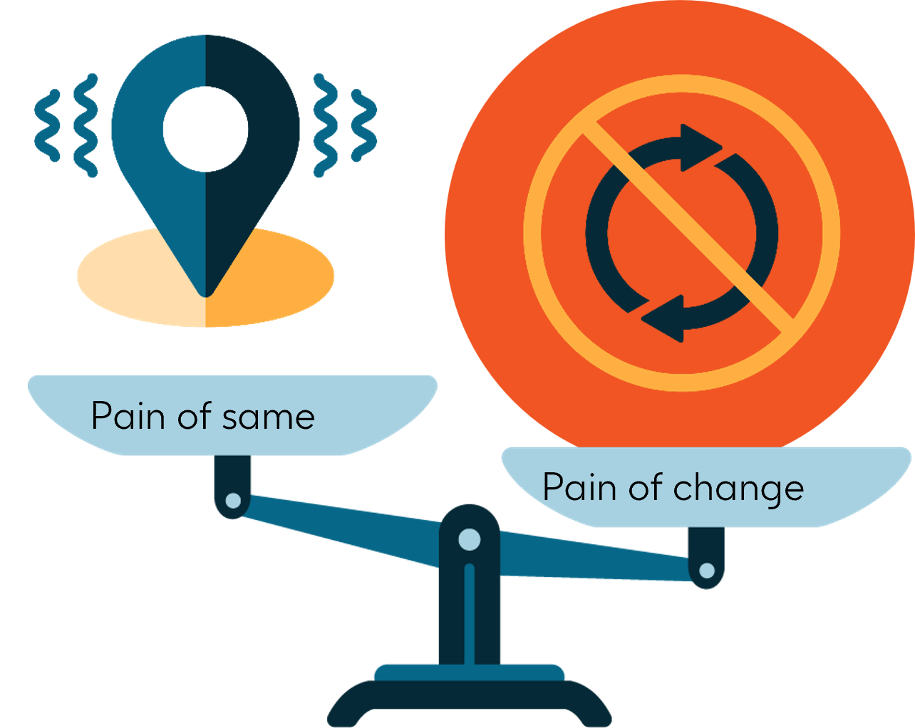
Introduce the Impact
Building the RATIONAL Case for Change
Building EMOTIONAL Case for Change
Risk of Exacerbations
All-cause mortality (ACM) risk
Emotional Impacts helps
Tell the Story of what the ‘Pain of Same’ looks like
Personalize impact by putting a human face to the problem
“Doctor, studies have shown that a single exacerbation can trigger more symptoms and accelerated disease progression and in severe cases potentially duplicate the risk of mortality over 5 years. This is the risk some patients face.
"Doctor, I'd like to share the story of Humberto, a 65-year-old patient who envisioned an active retirement, traveling with his family and enjoying life. Unfortunately, his COPD and the fear of hospitalization have made those plans impossible.
In your experience, how many of your patients might be facing similar challenges to Humberto?"
…Doctor, what considerations do you take into account when choosing treatment among your COPD patients who are at risk of exacerbations?”
The sample dialogue provided in this presentation are for illustrative purposes only.
These materials must be reviewed and locally approved by the Medical Affairs team prior to use in any healthcare professional (HCP) interactions.
Notes:
Everyday our HCPs, in every patient encounter, need to make decisions. They need to balance patient outcomes, experience, guidelines etc. These decisions often come down to a choice: continue with established habits or embrace new approaches. This is where the concept of "pain of same" and "pain of change" comes into play.
In order to introduce the impact, there are 2 elements which must be present in order to be most effective…
First, the RATIONAL Case for change – this is where we anchor impact of sizable, quantifiable impact –
Second, the EMOTIONAL Case

Slide 15



EMOTIVE SELLING TACTICS
Utilize emotive selling concepts to convey the emotional case for change
Dial up the Constructive Tension your story creates with:
Vivid Equivalents
Connect abstract data points to a more concrete and relatable measure
Imagery
Incorporate details that invoke the five senses
Analogies
Create a comparison to make your point more memorable
Example: "That’s how our patients feel when they are experiencing exacerbations—like being caught underwater, desperately trying to reach the surface but held back by an invisible weight pressing down on their chest. Each inhale feels shallow and strained, as if the air they need is just out of reach. The overwhelming sense of suffocation can leave them panicked, exhausted, and unable to focus on anything else. Even simple activities, like walking across the room or climbing a few steps, can seem like insurmountable obstacles. This is the daily battle for many living with COPD, and it fuels our determination to create treatments that bring them relief and restore their ability to breathe freely."
Example:
"The simple act of walking across the room feels as draining as climbing 20 flights of stairs for someone without COPD."
"It’s like carrying a 50-pound weight on your chest while trying to run a marathon. The effort to draw in air feels overwhelming, and even resting doesn’t bring relief."
Example: like trying to sip air through a straw riddled with tiny holes
Notes:
FULL BUILD TIMING: 4 mins across 5 slides
SLIDE TIMING: 1 min RUNNING TIME: 2:35-2:36
FLOW (SLIDE 5 OF 5)
Discuss how to use vivid equivalents
TRANSITION
Again, the point of Emotional Impact is to help the customer get their head around just how bad things currently are…

Slide 16
Build your own “Challenge” to Status Quo
Suggested
Activity
Last time we met, you explained…
That being said…
Some pulmonologists do not realize that…

Slide 17
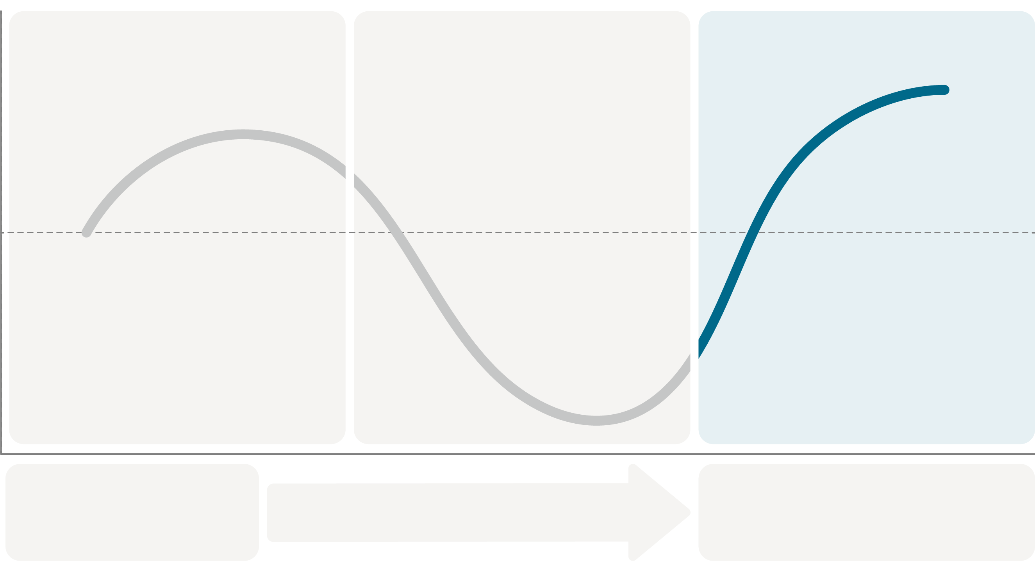
Focusing On: Reveal Value
Positive
Share Reframe
Introduce Impact
Reveal Value
Reveal Value:
Demonstrate the value of adopting a new way forward and reveal the distinctiveness of your solution.
Customer Emotional State
Neutral
Negative
A
B
GAP
Current State
New Approach
Notes:
Now that you have introduced the impact, you may now be ready to reveal the value.
The objective is to Demonstrate the value of adopting a new way forward and reveal the distinctiveness of your solution.

Slide 18


Offering a New Way Forward
A
B
GAP
Current State
New Approach
Captures the customer’s current thinking
What the customer is missing
Offers a new way to address the problem (leading to your solution)
What should your customer do differently/how should they change their behavior?
How would your customer describe the new approach in their language?
Revealing Value might sound like:
The good news is, this is an easy fix…
Imagine if there was a way to…
Wouldn't it be great if you could…
Now imagine a scenario where instead of X you…
Notes:
SLIDE TIMING: 2 mins RUNNING TIME: 2:59-3:01
FLOW
Discuss the action the customer should take
Discuss the idea of differentiating your solution from others
TRANSITION
As you think about what this might sound like, we have a few ideas for you to consider…

Slide 19
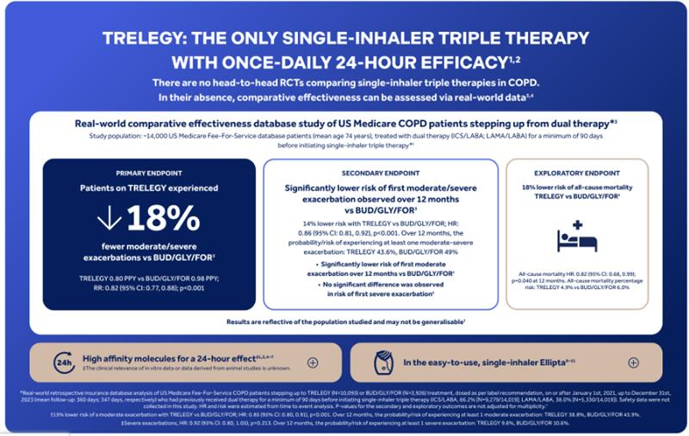
Reveal Value of Trelegy thru CES
“Doctor, that’s where Trelegy changes the conversation. Its superiority has been consistently demonstrated in multiple clinical trials as well as in individual molecules. And now, with real-world head-to-head data comparing Trelegy and Breztri, we have an opportunity to make decisions based on what works in patients' daily lives…”
“Thank you doctor, to summarize our discussion, these are the key highlights of the CES Study…
“For your COPD patients, will you be willing to step-up to Trelegy instead of Breztri for COPD patients at risk of exacerbation?
“How best can I follow up with you on this” (Omnichannel action)
Appropriately choose the data relevant to approved prescribing information in your LOC
The sample dialogue provided in this presentation are for illustrative purposes only.
These materials must be reviewed and locally approved by the Medical Affairs team prior to use in any healthcare professional (HCP) interactions.
Notes:
12% switching from mono/dual/no therapy (broader population) experiencing the benefit of Trelegy vs previous treatment)
18% treated with ICS/LABA or LAMA/LABA (dual to triple benefit)

Slide 20
A 3-Phase Message
In summary
Positive
Share Reframe
Introduce Impact
Reveal Value
Customer Emotional State
Neutral
Negative
A
B
GAP
Current State
New Approach

Slide 21
Turning a Message into a Conversation
Summary
Doctor, based on our previous conversations, you've emphasized your goal of helping patients reduce symptoms quickly while minimizing their risk of exacerbations and you have seen how Triple Therapies can address this. However, many pulmonologists use triple therapies interchangeably, assuming they deliver similar outcomes. This means that patients are not getting the most of the treatment, possibly, leading to higher risk of exacerbation
Share Reframe
“Doctor, studies have shown that a single exacerbation can trigger more symptoms and accelerated disease progression and in severe cases potentially duplicate the risk of mortality over 5 years.
…Doctor, what considerations do you take into account when choosing treatment among your COPD patients at risk of exacerbations?”
"Doctor, I'd like to share the story of Humberto, a 65-year-old patient who envisioned an active retirement, traveling with his family and enjoying life. Unfortunately, his COPD and the fear of hospitalization have made those plans impossible.
In your experience, how many of your patients might be facing similar challenges to Humberto?"
Introduce Impact
“Doctor, that’s where Trelegy changes the conversation. Its superiority has been consistently demonstrated in multiple clinical trials as well as in individual molecules. And now, with real-world head-to-head data comparing Trelegy and Breztri, we have an opportunity to make decisions based on what works in patients' daily lives…”
Reveal Value
The sample dialogue provided in this presentation are for illustrative purposes only.
These materials must be reviewed and locally approved by the Medical Affairs team prior to use in any healthcare professional (HCP) interactions.

